Slide 1
Traditional Agents
Antimetabolites
Purine Analogues
Mercaptopurine
Pyrimidine Analogues
5-FU
Gemcitabine
Capecitabine
Cytarabine
Floxuridine
Folate Antagonist
Methotrexate
Pemetrexed
Alkylating Agents
Classical Alkylating Agents
Nitrogen Mustards
Nitrogen Mustard
Melphalan
Cyclophosphamide
Ifosfamide
Nitrosoureas
Carmustine
Non-Classical Alkylating Agents
Procarbazine
Dacarbazine
Temolomide
Alkylating-Like
Cisplatin
Carboplatin
Oxaliplatin
Plant Alkaloids
Vinca alkaloid
Vincristine
Vinblastine
Vinorelbine
Taxanes
Paxitaxel
Docetaxel
Enzyme inhibitors
Topoisomerase 1 Inhibitor
Irinotecan
Topotecan
Topoisomerase 2 Inhibitor
Etoposide
Anthracyclines
Doxyrubicin
Daunorubicin
Idarubicin
Epirubicin
Mitoxantrone
Antitumor Antibiotics
Mitomycin
Bleomycin
Targeted agents
Monoclonal Antibodies (Mab)
Lymphocyte Antigens
Alemtuzumab
Ibritumomab Tiuxetan
Rituximab
HER-2 neu
Trastuzumab
Lapatinib
EGFR inhibitors
Cetuximab
Panitumumab
VEGF
Bevacizumab
Tyrosine Kinase Inhibitors
Sorafenib
Sunitinib
Dasatinib
Nilotinib
Imatinib
M-TOR Inhibitors
Endocrine
Endocrine Agonist
Megestrol
LHRH Analogs
Goserelin
Leuprolide
abarelix
Androgens
Endocrine Antagonist
SERMS
Tamoxifen
Toremifene
Fulvestrant
Anti-androgens
Bicalutamide
Flutamide
Nilutamide
Aromatase inhibitors
Anastrozole
Letrozole
Exemestane
Antineoplastic
Monoclonal antibodies

Slide 2
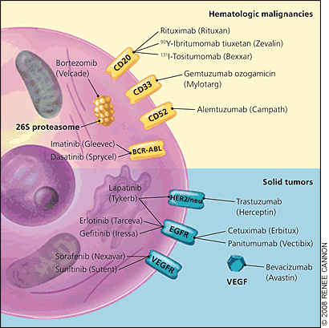

Slide 3
Monoclonal Antibodies (Mab)
Lymphocyte Antigens
HER-2 neu
Alemtuzumab
Ibritumomab Tiuxetan
Rituximab
Trastuzumab
Lapatinib
EGFR inhibitors
Cetuximab
Panitumumab
VEGF
Bevacizumab

Slide 4
Lymphocyte Antigens | Use
Alemtuzumab | Binds to CD52
Ibritumomab | Binds to CD20 and Radioactive isotope
Rituximab | Binds to CD20 Activates cell lysis
S/E | Management
Infusion Rxn Arthralgias Immunosuppression | 1. Infuse slowly 2. Premedicate with: corticosteroids + Diphenhydramine APAP No live vaccines
HER-2 neu | Use | S/E | Additional Tx
Trastuzumab | 1st line for HER + Breast cancer in Early and advanced stage | Cardiotoxicity Infusion rxn
Lapatinib |  | Cardiotoxicity

Slide 5
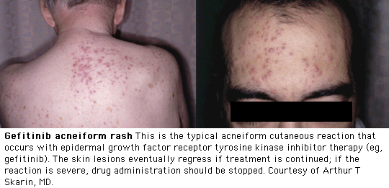
EGFR inhibitors; competitively inhibits the binding of ligands to EGFR preventing autophosphorylation and activation of receptor-associated kinases.
EGFR
Cetuximab (Erbitux)
Panitumumab (Vectibix)
S/E | Additional Tx
90% Rash → infection | If infected: Tetracyclines Or Topical Clindamycin
Monoclonal antibody that targets vascular endothelial growth factor (VEGF)
VEGF | Use | S/E | Additional Tx
Bevacizumab (Avastin) | Colorectal cancer Non-squamous lung cacner Renal cell carcinoma Glioblastoma | HTN Poor wound healing | Make sure BP is under control and fully healed 8 weeks prior

Slide 6
MOA
Generic Name | Brand Name | Mechanism of action
Rituximab | Rituxan® | CD-20 B cells
Alemtuzumab | Campath® | CD-52
Cetuximab | Erbitux® | EGFR
Panitumumab | Vectibix® | EGFR
Trastuzumab | Herceptin® | HER/2neu
Lapatinib | Tykerb® | Her/2neu / EGFR
Imatinib | Gleevec® | Ph chromosome
Dasatinib | Sprycel® | Ph chromosome
Nilatinib | Tasigna® | Ph chromosome
Sunitinib | Sutent® | VEGF
Sorafenib | Nexavar® | VEGF
Bevacizumab | Avastin® | VEGF
Temsirolimus | Torisel® | M-TOR

